Slide 1
FLIGHT PLAN 2028
BALANCED SCORECARD ESSENTIALS

Slide 2
BALANCED SCORECARD ESSENTIALS
BALANCED SCORECARD
EXECUTION PREMIUM PROCESS (XPP)
DEVELOP THE STRATEGY
PLAN THE STRATEGY

Slide 3
BALANCED SCORECARD ESSENTIALS
BALANCED SCORECARD

Slide 4
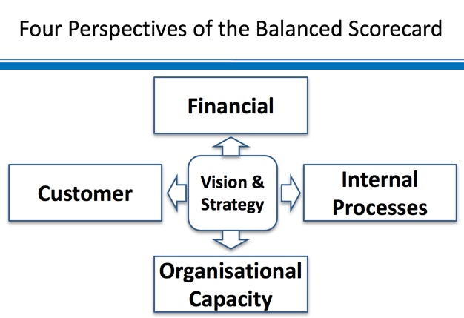
BALANCED SCORECARD ESSENTIALS

Slide 5
BALANCED SCORECARD ESSENTIALS
ACCOMPLISHED CRITICAL MANAGEMENT PROCESSES
Clarify and translate visions and strategy
Communicate and link strategic objectives and measures
Plan, set targets, and align strategic initiatives
Enhance strategic feedback and learning

Slide 6
BALANCED SCORECARD ESSENTIALS
The Balanced Scorecard functions as:

Slide 7
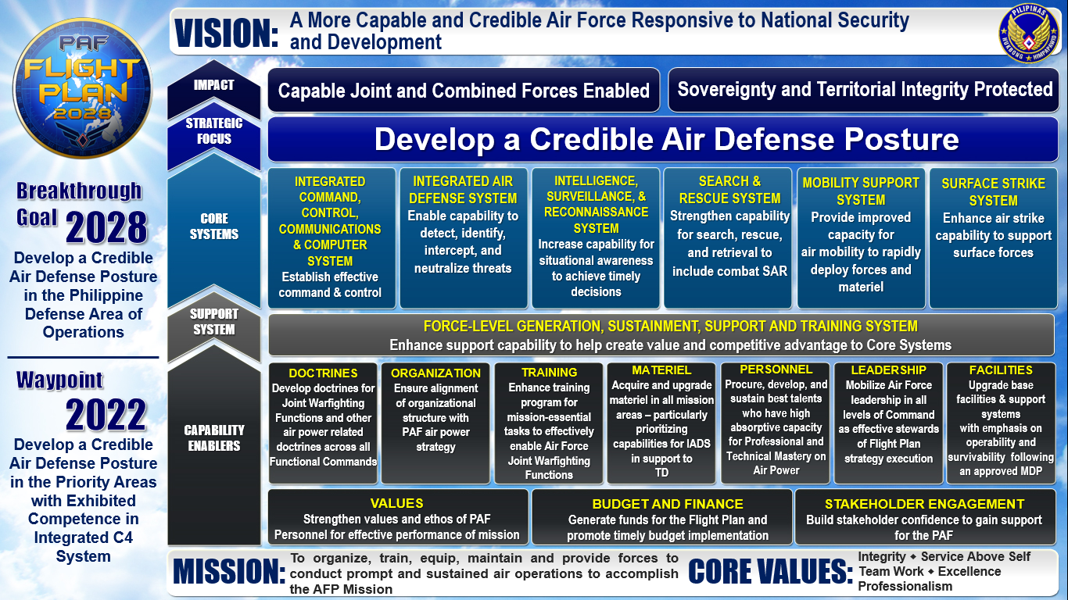
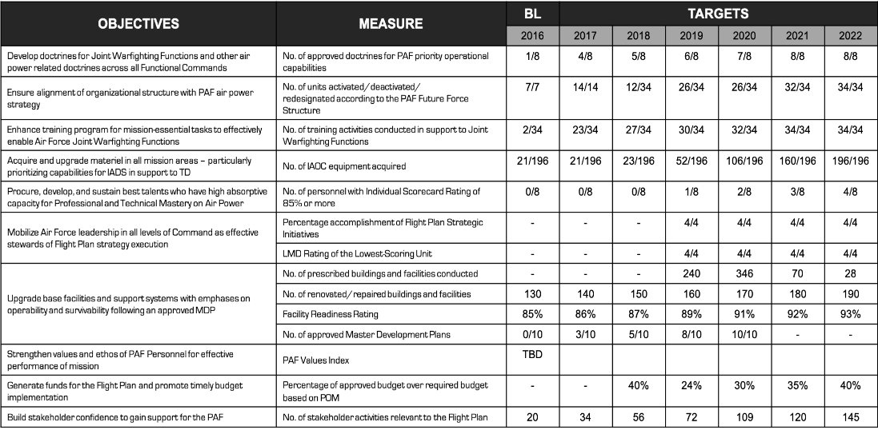
BALANCED SCORECARD ESSENTIALS
The Balanced Scorecard components are:
Strategy Map
Portfolio of Strategic Initiatives
Performance Scorecard

Slide 8
BALANCED SCORECARD ESSENTIALS
Why use the Balanced Scorecard?
CURRENT
DESIRED
GAP

Slide 9
BALANCED SCORECARD ESSENTIALS
EXECUTION
PREMIUM
PROCESS
(XPP)

Slide 10
BALANCED SCORECARD ESSENTIALS
Role Clarification
Identifying of Stakeholders
Problem and Objective Analysis
Develop the Strategy
Consolidate long-term trends and data on strategy
Reintroduce minor changes to strategy planning
Determine if there is need to ”refresh” strategy
Crafting the Strategic Objectives into a Strategy Map
Generation of Measures and Targets for the Scorecard
Formulation of Strategic Initiatives
Report and evaluate accomplishment of initiatives
Determine if targets are being reached
Identify if measures are responsive
Plan the
Strategy
Link strategy to budget process
Link strategy to communication systems
Link strategy to accountability mechanisms
Test and
Adapt
Align strategies and scorecards with lower units
Align individual performance evaluation with strategy
Align the Organization
Monitor
and Learn
Plan
Operations

Slide 11
Develop the Strategy
START

Slide 12
Develop the Strategy
START
Core Values, Mission
Role Clarification (“What is the Air Force mandated to do exactly?”):
Customer-Outcome Analysis
Value Chain Analysis
Stakeholder, Problem, and Objective Analysis

Slide 13
Develop the Strategy
START
Core Values, Mission
Role Clarification (“What is the Air Force mandated to do exactly?”):
Customer-Outcome Analysis
Value Chain Analysis
Stakeholder, Problem, and Objective Analysis
Vision
Change Agenda

Slide 14
Develop the Strategy
START
Core Values, Mission
Role Clarification (“What is the Air Force mandated to do exactly?”):
Customer-Outcome Analysis
Value Chain Analysis
Stakeholder, Problem, and Objective Analysis
Vision
Change Agenda
GOVERNANCE CHARTER

Slide 15
Plan the Strategy
Vision
Change Agenda

Slide 16
Plan the Strategy
Vision
Change Agenda
STRATEGY MAP
Strategic Objectives
Based on Strategic Perspectives:
Impact
Strategic Focus
Core Systems
Capability Enablers

Slide 17
Plan the Strategy
Vision
Change Agenda
STRATEGY MAP
Strategic Objectives
Based on Strategic Perspectives:
Impact
Strategic Focus
Core Systems
Capability Enablers

Slide 18
Plan the Strategy
Vision
Change Agenda
STRATEGY MAP
Strategic Objectives
Based on Strategic Perspectives:
Impact
Strategic Focus
Core Systems
Capability Enablers
Strategy Measures
ENTERPRISE SCORECARD

Slide 19
Plan the Strategy
Vision
Change Agenda
STRATEGY MAP
Strategic Objectives
Based on Strategic Perspectives:
Impact
Strategic Focus
Core Systems
Capability Enablers
Strategy Measures
Targets
Measure Profiles
ENTERPRISE SCORECARD

Slide 20
Plan the Strategy
Vision
Change Agenda
STRATEGY MAP
Strategic Objectives
Based on Strategic Perspectives:
Impact
Strategic Focus
Core Systems
Capability Enablers
Strategy Measures
Targets
Measure Profiles
ENTERPRISE SCORECARD

Slide 21
Plan the Strategy
Vision
Change Agenda
STRATEGY MAP
Strategic Objectives
Based on Strategic Perspectives:
Impact
Strategic Focus
Core Systems
Capability Enablers
Strategy Measures
Targets
Portfolio of Initiatives
Measure Profiles
DMF (with KPIs based on Scorecard)
Work Breakdown Structure
Gantt Chart
Costing
ENTERPRISE SCORECARD

Slide 22
Align the Organization
Strategic Objectives
Strategy Measures
Targets
Initiatives
ENTERPRISE SCORECARD

Slide 23
Align the Organization
Strategic Objectives
Strategy Measures
Targets
Initiatives
ENTERPRISE SCORECARD
Unit #1 Mandate
Unit #2 Mandate

Slide 24
Align the Organization
Strategic Objectives
Strategy Measures
Targets
Initiatives
ENTERPRISE SCORECARD
Unit #1 Mandate
Unit #1 Objectives
Unit #2 Mandate
Unit #2 Objectives

Slide 25
Align the Organization
Strategic Objectives
Strategy Measures
Targets
Initiatives
ENTERPRISE SCORECARD
Unit #1 Mandate
Unit #1 Objectives
Unit #1 Measures
Unit #1 Targets
Measure Profiles
Unit #2 Mandate
Unit #2 Objectives
Unit #2 Measures
Unit #2 Targets
Measure Profiles

Slide 26
Align the Organization
Strategic Objectives
Strategy Measures
Targets
Initiatives
ENTERPRISE SCORECARD
Unit #1 Mandate
Unit #1 Objectives
Unit #1 Measures
Unit #1 Targets
Measure Profiles
UNIT #1 SCORECARD
Unit #2 Mandate
Unit #2 Objectives
Unit #2 Measures
Unit #2 Targets
Measure Profiles
UNIT #2 SCORECARD

Slide 27
Align the Organization
Strategic Objectives
Strategy Measures
Targets
Initiatives
ENTERPRISE SCORECARD
Unit #1 Mandate
Unit #1 Objectives
Unit #1 Measures
Unit #1 Targets
Unit #1 Initiatives
Measure Profiles
UNIT #1 SCORECARD
Unit #2 Mandate
Unit #2 Objectives
Unit #2 Measures
Unit #2 Targets
Unit #2 Initiatives
Measure Profiles
UNIT #2 SCORECARD

Slide 28
Align the Organization
Strategic Objectives
Strategy Measures
Targets
Initiatives
ENTERPRISE SCORECARD
Unit #1 Mandate
Unit #1 Objectives
Unit #1 Measures
Unit #1 Targets
Unit #1 Initiatives
Measure Profiles
UNIT #1 SCORECARD
Unit #2 Mandate
Unit #2 Objectives
Unit #2 Measures
Unit #2 Targets
Unit #2 Initiatives
Measure Profiles
UNIT #2 SCORECARD
Individual Performance Measures
Individual Targets

Slide 29
Align the Organization
Strategic Objectives
Strategy Measures
Targets
Initiatives
ENTERPRISE SCORECARD
Unit #1 Mandate
Unit #1 Objectives
Unit #1 Measures
Unit #1 Targets
Unit #1 Initiatives
Measure Profiles
UNIT #1 SCORECARD
Unit #2 Mandate
Unit #2 Objectives
Unit #2 Measures
Unit #2 Targets
Unit #2 Initiatives
Measure Profiles
UNIT #2 SCORECARD
Individual Performance Measures
Individual Targets
INDIVIDUAL SCORECARD

Slide 30
Plan Operations
Strategy Measures
Targets
Initiatives
ENTERPRISE SCORECARD

Slide 31
Plan Operations
Strategy Measures
Targets
Initiatives
ENTERPRISE SCORECARD
Process Alignment

Slide 32
Plan Operations
Strategy Measures
Targets
Initiatives
ENTERPRISE SCORECARD
Process Alignment
Alignment of Resources
Alignment of Expectations
Alignment of Messages

Slide 33
Plan Operations
Strategy Measures
Targets
Initiatives
ENTERPRISE SCORECARD
Process Alignment
Alignment of Resources
Alignment of Expectations
Alignment of Messages
Link Initiative Funding to
PAF Budget
POM
DSOM (through creation of PAF Strat Mgt System)
PPBER

Slide 34
Plan Operations
Strategy Measures
Targets
Initiatives
ENTERPRISE SCORECARD
Process Alignment
Alignment of Resources
Alignment of Expectations
Alignment of Messages
Link Initiative Funding to
PAF Budget
Link Strategy to
Accountability Systems
POM
DSOM (through creation of PAF Strat Mgt System)
PPBER
AGI
Internal Audit
Project Evaluation Schemes
FP Monitoring System

Slide 35
Plan Operations
Strategy Measures
Targets
Initiatives
ENTERPRISE SCORECARD
Process Alignment
Alignment of Resources
Alignment of Expectations
Alignment of Messages
Link Initiative Funding to
PAF Budget
Link Strategy to
Accountability Systems
Link Strategy Messages to Existing Communication Processes
POM
DSOM (through creation of PAF Strat Mgt System)
PPBER
AGI
Internal Audit
Project Evaluation Schemes
FP Monitoring System
Stakeholder Engagement
Strategic Communication Plans
Training Programs
Cascading Activities

Slide 36
Plan Operations
Strategy Measures
Targets
Initiatives
ENTERPRISE SCORECARD
Process Alignment
Alignment of Resources
Alignment of Expectations
Alignment of Messages
Link Initiative Funding to
PAF Budget
Link Strategy to
Accountability Systems
Link Strategy Messages to Existing Communication Processes
POM
DSOM (through creation of PAF Strat Mgt System)
PPBER
AGI
Internal Audit
Project Evaluation Schemes
FP Monitoring System
Stakeholder Engagement
Strategic Communication Plans
Training Programs
Cascading Activities
Implementation of Initiatives

Slide 37
Monitor and Learn
Strategy Measures
Targets
Initiatives
ENTERPRISE SCORECARD
Implementation of Initiatives
Link Strategy to
Accountability Systems
AGI
Internal Audit
Command Evaluation Schemes
FP Monitoring System

Slide 38
Monitor and Learn
Strategy Measures
Targets
Initiatives
ENTERPRISE SCORECARD
Implementation of Initiatives
Link Strategy to
Accountability Systems
AGI
Internal Audit
Command Evaluation Schemes
FP Monitoring System
Initiatives Review

Slide 39
Monitor and Learn
Strategy Measures
Targets
Initiatives
ENTERPRISE SCORECARD
Implementation of Initiatives
Link Strategy to
Accountability Systems
AGI
Internal Audit
Command Evaluation Schemes
FP Monitoring System
”Are we completing initiatives?”
”Are we achieving targets based on initiative performance?”
Initiatives Review

Slide 40
Monitor and Learn
Strategy Measures
Targets
Initiatives
ENTERPRISE SCORECARD
Implementation of Initiatives
Link Strategy to
Accountability Systems
Strategy Review
AGI
Internal Audit
Command Evaluation Schemes
FP Monitoring System
”Are we completing initiatives?”
”Are we achieving targets based on initiative performance?”
Initiatives Review

Slide 41
Monitor and Learn
Strategy Measures
Targets
Initiatives
ENTERPRISE SCORECARD
Implementation of Initiatives
“Are the targets sensible/achievable?”
“Are the measures still responsive?”
“Are there difficulties in measurement/
target achievement?”
Link Strategy to
Accountability Systems
Strategy Review
AGI
Internal Audit
Command Evaluation Schemes
FP Monitoring System
”Are we completing initiatives?”
”Are we achieving targets based on initiative performance?”
Initiatives Review

Slide 42
Test and
Adapt
Link Strategy to
Accountability Systems
AGI
Internal Audit
Command Evaluation Schemes
FP Monitoring System
Strategy Review
Initiatives Review

Slide 43
Test and
Adapt
Link Strategy to
Accountability Systems
AGI
Internal Audit
Command Evaluation Schemes
FP Monitoring System
Strategy Review
Initiatives Review
Changes in Initiatives

Slide 44
Test and
Adapt
Link Strategy to
Accountability Systems
AGI
Internal Audit
Command Evaluation Schemes
FP Monitoring System
Strategy Review
Run “Align Organization” and succeeding stages again with revised Scorecard or Initiatives
Initiatives Review
Changes in Initiatives

Slide 45
Test and
Adapt
Link Strategy to
Accountability Systems
AGI
Internal Audit
Command Evaluation Schemes
FP Monitoring System
Strategy Review
Changes in Measures or Targets
Run “Align Organization” and succeeding stages again with revised Scorecard or Initiatives
Initiatives Review
Changes in Initiatives

Slide 46
Test and
Adapt
Environment Change
Change in priorities of higher-ups (AFP, DND, Executive branch)
Link Strategy to
Accountability Systems
AGI
Internal Audit
Command Evaluation Schemes
FP Monitoring System
Strategy Review
Changes in Measures or Targets
Run “Align Organization” and succeeding stages again with revised Scorecard or Initiatives
Initiatives Review
Changes in Initiatives

Slide 47
Test and
Adapt
Environment Change
Change in priorities of higher-ups (AFP, DND, Executive branch)
Changes in Objectives, Vision, or Role
Link Strategy to
Accountability Systems
AGI
Internal Audit
Command Evaluation Schemes
FP Monitoring System
Strategy Review
Changes in Measures or Targets
Run “Align Organization” and succeeding stages again with revised Scorecard or Initiatives
Initiatives Review
Changes in Initiatives

Slide 48
Test and
Adapt
Environment Change
STRATEGY REFRESH
Run “Develop the Strategy” and succeeding stages again with revised role, vision, or objectives
Change in priorities of higher-ups (AFP, DND, Executive branch)
Changes in Objectives, Vision, or Role
Link Strategy to
Accountability Systems
AGI
Internal Audit
Command Evaluation Schemes
FP Monitoring System
Strategy Review
Changes in Measures or Targets
Run “Align Organization” and succeeding stages again with revised Scorecard or Initiatives
Initiatives Review
Changes in Initiatives

Slide 49
BALANCED SCORECARD ESSENTIALS
DEVELOP THE STRATEGY

Slide 50
PROBLEM AND OBJECTIVE ANALYSIS
GOVERNANCE
CHARTER
STAKEHOLDER
ANALYSIS

Slide 51
BALANCED SCORECARD ESSENTIALS
What comprises the Governance Charter?

Slide 52
GOVERNANCE CHARTER
VISION
A statement saying what the organization wants to be after a determined period of time
MISSION
A statement saying what the organization is mandated to do (the function of the organization)
CORE VALUES
Principles that the organization embodies and takes into heart in all that it does

Slide 53
PAF GOVERNANCE CHARTER
VISION
A more capable and credible Air Force responsive to national security and development
MISSION
To organize, train, equip, maintain and provide forces to conduct prompt and sustained air operations to accomplish the AFP mission
CORE VALUES
Integrity | Service above Self | Teamwork | Excellence | Professionalism

Slide 54
BALANCED SCORECARD ESSENTIALS
How do we perform Stakeholder Analysis?

Slide 55
STAKEHOLDER ANALYSIS
NAME OF UNIT:
Stakeholder | Stakeholder’s Interests | Perception of Problems | Resources | Mandate
People, groups, or sectors your unit is involved with | What the stakeholder wants or expects to get from you | What the stakeholders think are issues in terms of their interests | What resources the stakeholder has | What the stakeholder is supposed to do

Slide 56
Stakeholder | Stakeholder’s Interest | Perceived Problems | Resource | Mandate
Passengers | Safe, reliable, and reasonable public transport | Many delays Frequent bus breakdowns Frequent accidents with passenger injuries Impolite drivers Dangerous driving | Willingness to pay for improved services | Not applicable
Private car owners | No traffic jams and safe roads | Too many accidents caused by buses Bus drivers drive dangerously | May consider use of public transport if reliable and safe | Not applicable
Union of bus drivers | Improved working conditions for bus drivers | Low salaries Unreasonable working hours Poor road maintenance Old and poorly maintained buses | Can mobilize bus drivers to strike (100% membership) Strong collective bargaining power | To represent the interests of its members
Motor mechanics | Reliable supply of spare parts | Poor stock management | Technical skills | Not applicable
Safari Bus Company management | Provide cost-effective, safe, and reliable transport services | Old fleet of buses Irregular bus maintenance Unreliable supply of spare parts Poorly skilled mechanics Fares cover only 70% of operating budget | Near monopolist Fleet of buses Operating budget Government subsidies | To represent the interests of its members

Slide 57
BALANCED SCORECARD ESSENTIALS
How do we perform Problem/Objective Analysis?

Slide 58
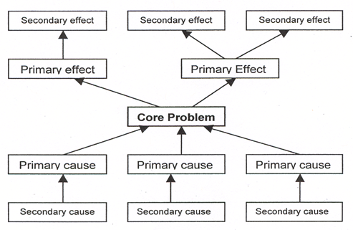
BALANCED SCORECARD ESSENTIALS
PROBLEM ANALYSIS
Development of a problem tree – second diagnostic tool in situation analysis. Used to:
Analyze existing situation surrounding a given development problem context
Identify the major related problems and constraints associated with the development problem
Visualize the cause-effect relationship in a diagram.

Slide 59
BALANCED SCORECARD ESSENTIALS
STEPS IN PROBLEM ANALYSIS OR PROBLEM TREE
Discuss general situation and issues identify the development problem with the stakeholders, stating it as a negative situation.
Write the problems that are the direct causes of the development problem. Restrict the problems to those that are currently existing, do not anticipate future problems.
Repeat step 2, determine the direct causes for each of these problems.

Slide 60
BALANCED SCORECARD ESSENTIALS
STEPS IN PROBLEM ANALYSIS OR PROBLEM TREE
4. Identify the direct effects of the development problem.
5. Continue to place perceived effects of each problem.
6. Review the problem tree and analyze the interrelationship of problems at different levels.
7. Draw a line to identify each problem that is a cause to the problem that represents an effect.

Slide 61
BALANCED SCORECARD ESSENTIALS
Increased pollution
Increased per Capita transport cost
Drastic increase of private cars
Demand for SBC services declining
SBC public transport service is unreliable and unsafe
Frequent delays
Frequent breakdown of buses
Bus fleet is in poor condition
Poor Bus maintenance
Lack of spare parts
Import restrictions
Poorly skilled bus mechanics
No skills training testing
Buses are old
No investment budget
SBC runs operating loss
Fares only cover 75% of operating budget
Frequent bus accidents
Drivers have poor driving skills
No minimum driving skills required
Inadequate traffic management
Policy overwhelmed with increased traffic
Roads in poor condition
Small budget for maintenance
City Council has different priorities
Increased traffic congestion

Slide 62
BALANCED SCORECARD ESSENTIALS
How do we perform Objective Analysis?

Slide 63
BALANCED SCORECARD ESSENTIALS
OBJECTIVE ANALYSIS
Problems identified are turned into objectives
Describes a situation after the problems have been resolved
Identifies the means – end relationship
Visualizes the means-end relationship

Slide 64
BALANCED SCORECARD ESSENTIALS
OBJECTIVE ANALYSIS
Picture of the “changed situation”
Helps stakeholders imagine what is required to achieve change and maintain more control over planning the change
Facilitated the formulation of success indicators that are realistic, acceptable, and owned by the stakeholders

Slide 65
BALANCED SCORECARD ESSENTIALS
STEPS IN PERFORMING OBJECTIVE ANALYSIS
Reformulate the starter problem into an objective
Convert direct causes into objectives; add additional objectives as appropriate
Convert all problem statements into objective statements
**Objectives should be realistically achievable

Slide 66
BALANCED SCORECARD ESSENTIALS
STEPS IN PERFORMING OBJECTIVE ANALYSIS
Examine each statement above the starter objective, convert to positive statement
Review the objectives, ensure means-end relationship are valid
Complete the objectives tree by connecting the objectives with lines

Slide 67
Increased traffic congestion
Increased pollution
Increased per Capita transport cost
Drastic increase of private cars
Demand for SBC services declining
SBC public transport service is unreliable and unsafe
Frequent delays
Frequent breakdown of buses
Bus fleet is in poor condition
Poor Bus maintenance
Lack of spare parts
Import restrictions
Poorly skilled bus mechanics
No skills training testing
Buses are old
No investment budget
SBC runs operating loss
Fares only cover 75% of operating budget
Frequent bus accidents
Drivers have poor driving skills
No minimum driving skills required
Inadequate traffic management
Policy overwhelmed with increased traffic
Roads in poor condition
Small budget for maintenance
City Council has different priorities
Transport Cost per capita remains unchanged
Traffic flows smoothly
Exhaust pollution stabilized
Public transport is an attractive alternative to private transport
Growth of new private car registration stagnates
SBC provides reliable and safe public transport services
Road networks are well maintained
Bus schedule and utilization optimized
Bus accidents are rare
Bus fleet functions well
Drivers obey traffic rules
Police apply traffic control plan
City council focuses on road maintenance
Bus maintenance improved
Bus replacement schedule finalized
Special bus driving licenses introduced
Non-formal skills training and testing started
SBC achieves financial self sufficiency
Government grants import licenses for spare parts

Slide 68
BALANCED SCORECARD ESSENTIALS
ALTERNATIVE ANALYSIS
Also called Result Chain analysis
Identify alternative means to achieve the desired situation or objective
Assess the feasibility of each of the alternatives
Agree on a project strategy

Slide 69
BALANCED SCORECARD ESSENTIALS
STEPS IN PERFORMING ALTERNATIVE ANALYSIS
Select the desired objective
Identify sets or results chains of lower-level objectives from the objectives tree
Examine each means-end branch, result chain, to identify potential outputs and activities. Ensure that the results chain will lead to the project outcome.

Slide 70
Increased traffic congestion
Increased pollution
Increased per Capita transport cost
Drastic increase of private cars
Demand for SBC services declining
SBC public transport service is unreliable and unsafe
Frequent delays
Frequent breakdown of buses
Bus fleet is in poor condition
Poor Bus maintenance
Lack of spare parts
Import restrictions
Poorly skilled bus mechanics
No skills training testing
Buses are old
No investment budget
SBC runs operating loss
Fares only cover 75% of operating budget
Frequent bus accidents
Drivers have poor driving skills
No minimum driving skills required
Inadequate traffic management
Policy overwhelmed with increased traffic
Roads in poor condition
Small budget for maintenance
City Council has different priorities
Transport Cost per capita remains unchanged
Traffic flows smoothly
Exhaust pollution stabilized
Public transport is an attractive alternative to private transport
Growth of new private car registration stagnates
Roads
SBC provides reliable and safe public transport services
Bus Fleet
Road networks are well maintained
Bus schedule and utilization optimized
Bus accidents are rare
Drivers
Bus fleet functions well
Drivers obey traffic rules
Police apply traffic control plan
City council focuses on road maintenance
Bus maintenance improved
Bus replacement schedule finalized
Special bus driving licenses introduced
Non-formal skills training and testing started
SBC achieves financial self sufficiency
Government grants import licenses for spare parts

Slide 71
Increased traffic congestion
Increased pollution
Increased per Capita transport cost
Drastic increase of private cars
Demand for SBC services declining
SBC public transport service is unreliable and unsafe
Frequent delays
Frequent breakdown of buses
Bus fleet is in poor condition
Poor Bus maintenance
Lack of spare parts
Import restrictions
Poorly skilled bus mechanics
No skills training testing
Buses are old
No investment budget
SBC runs operating loss
Fares only cover 75% of operating budget
Frequent bus accidents
Drivers have poor driving skills
No minimum driving skills required
Inadequate traffic management
Policy overwhelmed with increased traffic
Roads in poor condition
Small budget for maintenance
City Council has different priorities
Transport Cost per capita remains unchanged
Traffic flows smoothly
Exhaust pollution stabilized
Public transport is an attractive alternative to private transport
Growth of new private car registration stagnates
Public Works
SBC provides reliable and safe public transport services
SBC Company
Road networks are well maintained
Bus schedule and utilization optimized
Bus accidents are rare
Police
Bus fleet functions well
Drivers obey traffic rules
Police apply traffic control plan
City council focuses on road maintenance
Bus maintenance improved
Bus replacement schedule finalized
Special bus driving licenses introduced
Non-formal skills training and testing started
SBC achieves financial self sufficiency
Government grants import licenses for spare parts

Slide 72
BALANCED SCORECARD ESSENTIALS
PLAN THE STRATEGY

Slide 73
BALANCED SCORECARD ESSENTIALS
STRATEGY
MAP
PERFORMANCE SCORECARD
STRATEGIC INITIATIVES

Slide 74
BALANCED SCORECARD ESSENTIALS
STRATEGY MAP
Main communication tool of the Balanced Scorecard
One-page graphical representation of what must be done well in each of the four perspectives in order to successfully execute strategy
Defines pathways that will lead to strategy execution

Slide 75
BALANCED SCORECARD ESSENTIALS
ESSENTIAL PRINCIPLES OF A STRATEGY MAP
The linkage of measures throughout the Strategy Map is constructed with a series of “if-then” statements.
Build capability to detect, identify, intercept and neutralize intrusions in the PADIZ and West PH Sea
BREAKTHROUGH
GOAL
Acquire and upgrade air defense equipment complemented by research and development
CORE PROCESSES
Upgrade base facilities and support system following an approved master development plan
SUPPORT PROCESS
Generate stakeholders’ support for the Flight Plan

Slide 76
BALANCED SCORECARD ESSENTIALS

Slide 77
BALANCED SCORECARD ESSENTIALS
What is Strategic Objective?

Slide 78
BALANCED SCORECARD ESSENTIALS
STRATEGIC OBJECTIVES
Action statements of what the strategy must achieve and what is critical to its success
Action statements that describe the specific things we must perform well for a successful strategy
Strategic choices that we have made from the many options we have
Addresses gaps that we have to fill to achieve our goal

Slide 79
BALANCED SCORECARD ESSENTIALS
WHAT MAKES A GOOD OBJECTIVE?
They are action statements clarifying strategy implementation.
They are linked priorities representing how strategy will be executed.

Slide 80
BALANCED SCORECARD ESSENTIALS
WHAT MAKES A GOOD OBJECTIVE?
VERB
ADJECTIVE
NOUN
action
description
result
Example:
Develop a Credible Air Defense Posture
Provide effective command and control
Provide air strike capability

Slide 81
BALANCED SCORECARD ESSENTIALS
MEASUREMENT IN BALANCED SCORECARD
Measurement is the very heart of the Balanced Scorecard
Performance Measures in the Scorecard monitor the course which allows us the organization that it remains on track.
Performance Measures are derived from objectives appearing on the Strategy Map, which itself serves as a direct and clarifying translation of the organization’s strategy

Slide 82
BALANCED SCORECARD ESSENTIALS
REASONS TO MEASURE PERFORMANCE
Drives desired behavior and gives individuals direction
Tests the organization’s progress in achieving strategic objectives
Shows the relationship between strategic objectives and tests the validity of the strategy

Slide 83
BALANCED SCORECARD ESSENTIALS
Key
Performance
Indicators

Slide 84
BALANCED SCORECARD ESSENTIALS
KEY PERFORMANCE INDICATORS (KPI)
Quantitative specifications for the desired project results
Indicate how to recognize the successful accomplishment of objectives
Help determine a performance target, which specifies quantity and time- how much and when.

Slide 85
BALANCED SCORECARD ESSENTIALS
If we can measure it,
we can manage it.

Slide 86
BALANCED SCORECARD ESSENTIALS
TYPES OF KPI
LEAD
LAG

Slide 87
BALANCED SCORECARD ESSENTIALS
TYPES OF KPI
LEAD
LAG
In-process measures and are predictive
Measures that drive the results in the lagging indicators
They predict performance of lagging indicators

Slide 88
BALANCED SCORECARD ESSENTIALS
TYPES OF KPI
LEAD
LAG
In-process measures and are predictive
Measures that drive the results in the lagging indicators
They predict performance of lagging indicators
An after-the-event measurement essential for charting progress
Output-oriented but hard to improve or influence
They are consequences of actions previously taken

Slide 89
BALANCED SCORECARD ESSENTIALS
TYPES OF KPI
OBJECTIVES | LEAD INDICATORS | LAG INDICATORS
Improve Physical Fitness | personal time spent for physical activities attendance to Taebo/Takbo calories intake | PFT results
Increase pool of applicants | number of info drives conducted extent of areas reached for info drive | number of applicants/examinees
Enhance knowledge of airmen on PAF doctrines | time spent for reading doctrines accessibility/availability to PAF doctrines number of doctrines published | evaluation of airmen’s knowledge (exam, survey)

Slide 90
BALANCED SCORECARD ESSENTIALS
STEPS TO DETERMINE KPI
Determine the basic indicator – what is to be measured?
Decide on the quantity – how much (increase/decrease)?
Describe the quality – what kind of change?
Add the time frame – by when?
specifies quantity and time- how much and when.

Slide 91
BALANCED SCORECARD ESSENTIALS
STEPS TO DETERMINE KPI
 | Outcome – The education system in the southeastern province provides higher-quality and equitable education
STEP 1: Determine the basic indicator – what is to be measured?
STEP 2: Decide on the quantity – how much (increase/decrease)?
STEP 3: Describe the quality – what kind of change?
STEP 4: Add the time frame – by when?

Slide 92
BALANCED SCORECARD ESSENTIALS
STEPS TO DETERMINE KPI
 | Outcome – The education system in the southeastern province provides higher-quality and equitable education
STEP 1: Determine the basic indicator – what is to be measured? | More and better-educated students graduate
STEP 2: Decide on the quantity – how much (increase/decrease)?
STEP 3: Describe the quality – what kind of change?
STEP 4: Add the time frame – by when?

Slide 93
BALANCED SCORECARD ESSENTIALS
STEPS TO DETERMINE KPI
 | Outcome – The education system in the southeastern province provides higher-quality and equitable education
STEP 1: Determine the basic indicator – what is to be measured? | More and better-educated students graduate
STEP 2: Decide on the quantity – how much (increase/decrease)? | The number of better-educated graduates increased from 10,000 to 25,000.
STEP 3: Describe the quality – what kind of change?
STEP 4: Add the time frame – by when?

Slide 94
BALANCED SCORECARD ESSENTIALS
STEPS TO DETERMINE KPI
 | Outcome – The education system in the southeastern province provides higher-quality and equitable education
STEP 1: Determine the basic indicator – what is to be measured? | More and better-educated students graduate
STEP 2: Decide on the quantity – how much (increase/decrease)? | The number of better-educated graduates increased from 10,000 to 25,000.
STEP 3: Describe the quality – what kind of change? | The number of graduates (55% female and 45% male) from lower-income families ($5,000 per annum) in the southeastern province passing a national standard examination increased from 10,000 to 25,000.
STEP 4: Add the time frame – by when?

Slide 95
BALANCED SCORECARD ESSENTIALS
STEPS TO DETERMINE KPI
 | Outcome – The education system in the southeastern province provides higher-quality and equitable education
STEP 1: Determine the basic indicator – what is to be measured? | More and better-educated students graduate
STEP 2: Decide on the quantity – how much (increase/decrease)? | The number of better-educated graduates increased from 10,000 to 25,000.
STEP 3: Describe the quality – what kind of change? | The number of graduates (55% female and 45% male) from lower-income families ($5,000 per annum) in the southeastern province passing a national standard examination increased from 10,000 to 25,000.
STEP 4: Add the time frame – by when? | The number of (55% female and 45% male) from lower-income families ($5,000 per annum) in the southeastern province passing a national standard examination increased from 10,000 to 25,000 per annum starting in year 4 of project implementation.

Slide 96
BALANCED SCORECARD ESSENTIALS
ALWAYS IDENTIFY THE SOURCE FOR THE KPI
OUTCOME | The education system in the southeastern province provides higher-quality and equitable education
KEY PERFORMANCE INDICATOR | The number of (55% female and 45% male) from lower-income families ($5,000 per annum) in the southeastern province passing a national standard examination increased from 10,000 to 25,000 per annum starting in year 4 of project implementation.
DATA SOURCE/REPORTING MECHANISM | Graduate rolls, confirmation report by the school’s Board of Regents, University Registrar records

Slide 97
BALANCED SCORECARD ESSENTIALS
REMINDERS FOR THE KPI
Performance indicators help clarify the design summary and can, at times, make it necessary to revise the design summary statements.
Indicators may be changed during project implementation. When changing an indicator, check if the respective results statement is still adequate.
Outputs, outcome, and impact are linked through a "cause-effect'' relationship. Hence, their respective indicators cannot logically be the same.
specifies quantity and time- how much and when.

Slide 98
BALANCED SCORECARD ESSENTIALS
Targets

Slide 99
BALANCED SCORECARD ESSENTIALS
TARGETS
For each measure, we must determine the target level of performance
Setting targets is generally a repeated and negotiated process among the leadership team

Slide 100
BALANCED SCORECARD ESSENTIALS
TARGETS
There can be a number of ways to approach this:
Derive a target from an overall goal
Create a breakthrough, stretch goal
Set incremental improvement based on historical performance
Benchmark other units/armed forces
Establish a baseline and define targets over time

Slide 101
BALANCED SCORECARD ESSENTIALS
TARGETS
Possible difficulties or consequences in setting targets
No data exist to support a defined target
Measure is brand new – no historical data exists
Organizational issues of freedom/autonomy
Fear and anxiety of targets/goals/measures
Effects on possible future reward and compensation

Slide 102
BALANCED SCORECARD ESSENTIALS
TARGETS
Criteria for Target
It should match a measure (one is to one is ideal)
It should be quantifiable
It should communicate the expected performance clearly

Slide 103
BALANCED SCORECARD ESSENTIALS
TARGETS: DEFINING KEY ATTRIBUTES OF A MEASURE PROFILE
STRATEGIC OBJECTIVE |  |  |  | MEASURE NAME |  |  |  |  |  |  |  | MEASURE OWNER |  |  | MEASURE NR
MEASURE DESCRIPTION
LEAD/LAG | FREQUENCY |  | UNIT TYPE |  |  | POLARITY |  | DATA SOURCE |  |  |  |  |  | DATA COLLECTOR
MEASURE FORMULA
BASELINE |  | TARGET
2017 |  | 2018 |  |  | 2019 |  |  |  | 2020 | 2021 |  |  | 2022
TARGET RATIONALE |  |  |  |  |  |  | PROBLEMS/RISKS IDENTIFIED |  |  |  | INITIATIVES

Slide 104
BALANCED SCORECARD ESSENTIALS
TARGETS: DEFINING KEY ATTRIBUTES OF A MEASURE PROFILE
State the Element and Strategic Objective provided in the Strategy Map that the measure is supporting
Example: "Materiel - Acquire and upgrade materiel in all mission areas – particularly prioritizing capabilities for IADS in support to Territorial Defense”

Slide 105
BALANCED SCORECARD ESSENTIALS
TARGETS: DEFINING KEY ATTRIBUTES OF A MEASURE PROFILE
State the clear name for the measure in its entirety
Example: PAF Values Index
Nr of air defense equipment acquired

Slide 106
BALANCED SCORECARD ESSENTIALS
TARGETS: DEFINING KEY ATTRIBUTES OF A MEASURE PROFILE
The owner is responsible for the results. Should the indicator’s performance begin to decline, it is the owner we look to for answers and a plan to bring results back in line with expectations
Example: Stakeholder Engagement PMT
Director for Operations

Slide 107
BALANCED SCORECARD ESSENTIALS
TARGETS: DEFINING KEY ATTRIBUTES OF A MEASURE PROFILE
The number of measure in the organization’s scorecard

Slide 108
BALANCED SCORECARD ESSENTIALS
TARGETS: DEFINING KEY ATTRIBUTES OF A MEASURE PROFILE
Fully explain why this measure is important to the accomplishment of the Strategic Focus
Example: “The PAF Values Index is the overall measurement of the PAF’s effort to strengthen organizational values of InSTEP among airmen expressed in numerical value purposely developed in monitoring the progress of the Core Process Values in the PAF Flight Plan 2028.”

Slide 109
BALANCED SCORECARD ESSENTIALS
TARGETS: DEFINING KEY ATTRIBUTES OF A MEASURE PROFILE
Identify whether the measure is a core outcome indicator (lag) or a performance driver (lead)

Slide 110
BALANCED SCORECARD ESSENTIALS
TARGETS: DEFINING KEY ATTRIBUTES OF A MEASURE PROFILE
This is the interval of updating/reporting the performance (weekly, monthly, quarterly, semi-annually, or yearly)

Slide 111
BALANCED SCORECARD ESSENTIALS
TARGETS: DEFINING KEY ATTRIBUTES OF A MEASURE PROFILE
This characteristic identifies how the measure will be expressed
Example: Percentage, Number, R-Rating, Time

Slide 112
BALANCED SCORECARD ESSENTIALS
TARGETS: DEFINING KEY ATTRIBUTES OF A MEASURE PROFILE
When assessing the performance of a measure, you need to know whether high values reflect good or bad performance

Slide 113
BALANCED SCORECARD ESSENTIALS
TARGETS: DEFINING KEY ATTRIBUTES OF A MEASURE PROFILE
Provide where the data is derived from
Example: Audit Reports, inspections, simulations

Slide 114
BALANCED SCORECARD ESSENTIALS
TARGETS: DEFINING KEY ATTRIBUTES OF A MEASURE PROFILE
Owner is accountable for the performance of the measure but Data Collector serves as the actual data contact
Example: OA-8, 15th Strike Wing, Wing Adjutant

Slide 115
BALANCED SCORECARD ESSENTIALS
TARGETS: DEFINING KEY ATTRIBUTES OF A MEASURE PROFILE
Provide the specific elements for calculation of the performance
Example:
$$\frac{\text{Number} \text{of} \text{Units} \text{to} \text{be} \text{activated}\text{, }\text{deactivated}\text{, }\text{downgraded}\text{, }\text{or} \text{upgraded} \text{for} \text{a} \text{given} \text{year}}{\text{Total} \text{number} \text{of} \text{Units} \text{to} \text{be} \text{restructured} \text{in} \text{a} \text{given} \text{period}}$$

Slide 116
BALANCED SCORECARD ESSENTIALS
TARGETS: DEFINING KEY ATTRIBUTES OF A MEASURE PROFILE
This is initial data collected that serves as the current level of performance

Slide 117
BALANCED SCORECARD ESSENTIALS
TARGETS: DEFINING KEY ATTRIBUTES OF A MEASURE PROFILE
This is the desired outcome for each year until the year 2022

Slide 118
BALANCED SCORECARD ESSENTIALS
TARGETS: DEFINING KEY ATTRIBUTES OF A MEASURE PROFILE
The rationale provides users with background on how you arrived at the particular target(s)
Example: The target list of equipment by 2022 will allow the PAF to achieve R3 in Priority Areas and is based on the Horizon 2 of AFP Modernization Program (Materiel)

Slide 119
BALANCED SCORECARD ESSENTIALS
TARGETS: DEFINING KEY ATTRIBUTES OF A MEASURE PROFILE
Indicate the problems/risks associated with the achievement of the strategic objective and targets through the Problem/Risk Assessment Matrix
Example: Lack of institutional memory
Rotation policy

Slide 120
BALANCED SCORECARD ESSENTIALS
TARGETS: DEFINING KEY ATTRIBUTES OF A MEASURE PROFILE
Indicate the Initiative Name(s) based on your Initiative Profile(s). The initiatives may address problems/issues that keeps performance low or prevents the achievement of the target. It may involve carefully studying the root causes of the problem/issues. Initiatives can be acted upon by the organization (internally).
Example: PAF Force Restructuring and Organizational Development

Slide 121
BALANCED SCORECARD ESSENTIALS
Strategic Initiatives

Slide 122
BALANCED SCORECARD ESSENTIALS
CHARACTERISTICS OF STRATEGIC INITIATIVES
Aim to significantly change the way we do things
Close a performance gap – support an objective on the strategy map
Have sponsorship at the leadership team level
Have definitive start and stop dates, and progress milestones
Have committed resource allocation or human and capital

Slide 123
BALANCED SCORECARD ESSENTIALS
DETERMINING THE GAPS IN STRATEGIC INITIATIVES
We should consider:
Strategic objective
The change agenda
Comprehensive examination of the problem/issue to determine the root cause/s
This will provide us choices

Slide 124
BALANCED SCORECARD ESSENTIALS
Design Summary

Slide 125
BALANCED SCORECARD ESSENTIALS
WHAT IS DESIGN SUMMARY?
outlines the main elements of the project
shows the vertical logic of the DMF explaining the means-ends relationship, also referred to as the results chain.

Slide 126
BALANCED SCORECARD ESSENTIALS
DESIGN SUMMARY
IMPACT
OUTCOME
OUTPUT
ACTIVITIES
INPUT

Slide 127
BALANCED SCORECARD ESSENTIALS
DESIGN SUMMARY
IMPACT
Also termed goal or longer-term objective
Refers to the generally sectoral or sub-sectoral objectives
Is influenced by many factors other than the project itself
Provides the link between the project and the strategy
OUTCOME
OUTPUT
ACTIVITIES
INPUT

Slide 128
BALANCED SCORECARD ESSENTIALS
DESIGN SUMMARY
Key anchor of the project design
Describes what the project intends to accomplish by the end of project implementation
Makes clear what development problem the project will address.
Determine the nature and scope of the outputs that will be necessary to achieve the outcome.
IMPACT
OUTCOME
OUTPUT
ACTIVITIES
INPUT

Slide 129
BALANCED SCORECARD ESSENTIALS
DESIGN SUMMARY
IMPACT
Physical and/or tangible goods and/or services delivered by the project
Describes the scope of the project
Must be necessary to achieve the outcome and the means-end relationship has to be clearly identified.
OUTCOME
OUTPUT
ACTIVITIES
INPUT

Slide 130
BALANCED SCORECARD ESSENTIALS
DESIGN SUMMARY
IMPACT
The groups of tasks carried out using project inputs to produce the desired outputs
Forms the basis for preparing the implementation schedule and a critical path analysis
OUTCOME
OUTPUT
ACTIVITIES
INPUT
INPUT

Slide 131
BALANCED SCORECARD ESSENTIALS
DESIGN SUMMARY
IMPACT
Main resources required to undertake the activities and to produce the outputs.
Includes:
lnputs by financier and main cost categories in financial and/or physical terms.
In-kind contributions from other stakeholders.
OUTCOME
OUTPUT
ACTIVITIES
INPUT

Slide 132
THANK YOU AND GOOD DAY!

